Slide 1


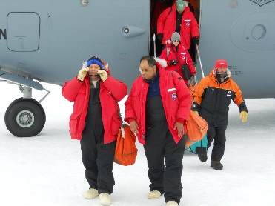
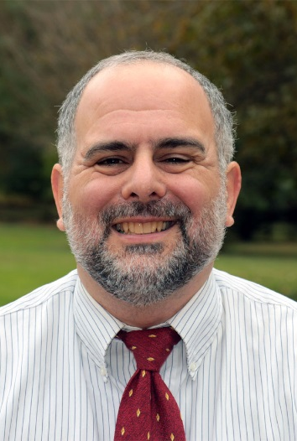
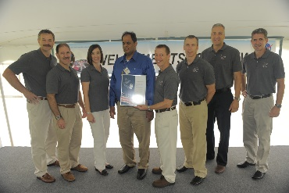

Federal Employment
Workshop
Federal Resume Information & Tips
Will be presented by Ms. Katherine Toth
Background Investigation Case Analyst with the
National Background Investigation Bureau
Two NASA Engineers talk about their work
Learn about Federal Resume Writing
Find out about ways the Federal Government works with employees with disabilities
Get information to prepare for the Fall 2019 FAPAC Job Fair at MC Rockville
Featured Speakers:
Marco Midon – NASA-Antenna Manager for the Geostationary Operational Environmental Satellite Project, developed at NASA and operated by NOAA. Mr. Midon has been fascinated by electronics and engineering since childhood. His first job at NASA was working on Solar Dynamics Observatory Ground stations – exponentially increasing the data gleaned from these by altering wavelengths. He developed the ground station for the Lunar Reconnaissance Orbiter which created the most complete map of the moon’s surface to date. In 2010 he traveled to Antarctica to provide engineering support for upgrading a ground antenna to provide better weather data to the US from European weather satellites. Also in 2010 he developed a “just in time” solution in less than 4 days to provide important flight data from the Soyuz space capsule’s re-entry into earth’s atmosphere. Mr. Midon has been blind since shortly after his birth.
Armen Caroglanian – Senior Electronics Engineer in the Telecommunication Networks & Technology Branch at NASA’s Goddard Space Flight Center. Over his career. Mr. Caroglanian has been involved in the development, procurement, installation, and testing of numerous NASA ground stations. Project highlights include the Second TDRSS Ground Terminal (STGT) antennas, Gamma Ray Observatory (GRO) Remote Terminal, Landsat-7 Ground Station, Search and Rescue (SAR) Ground Station Development, and support to the MILA Kennedy Space Center Ground Station.
In recent years Mr. Caroglanian has supported NASA optical communications as Facility Installation Manager for the Lunar Lasercom Ground Terminal (LLGT) and the Laser Communications Relay Demonstration (LCRD) Optical Ground Station (OGS-2).
Mr. Caroglanian holds BS and MS degrees in electrical engineering from the University of Maryland.
Marco Midon
NASA Antenna Manager
Above: front/right
Below: center in blue
Armen Caroglanian, RF
NASA Optical Ground Station
Engineer
This presentation will be useful for:
STEM Students ♦ Students with disabilities ♦ ALL Students interested in careers in the federal government
Friday, April 26, 2019 ♦ 1:00 pm – 3:00 pm ♦ Science Center, Room 462
Rockville
Campus

